Slide 1
Educational Data Warehouse
-AMMEN
LATEFA
VAIBHAV

Slide 2

Background
Currently, one of the top schools, the School of Information Studies at Syracuse University has an unorganized data system that is difficult to manage and maintain properly
In order for the institution to maintain their reputation and rankings the institution needs to be more organized and needs to take better decisions while handling heavy data and reports

Slide 3
Scope
To create a data warehouse for the educational system
To provide a functioning data warehouse that contains all the entries for the students, courses and employees
Features of a data warehouse are mentioned below:
Easily access student as it will be a large dataset
Improving the performance and provide reports

Slide 4
Sponsor/Champion
Inhouse
Dean
Head of departments
Faculty/staff
Board members

Slide 5

The team
Project manager
DBA
Technical Architect
ETL Developer
Front End Developer
OLAP Developer
Trainer
Data Modeler
QA Group

Slide 6
Business Reason
Direct benefits:
Simplification of data access
Enhanced system performance
Allows end users to perform extensive analysis
Indirect benefits:
Enhance business knowledge
Present competitive advantage
Facilitate decision making

Slide 7
Data Marts
The three data marts that we used for our data warehouse are:
Student Information
Course Catalogue
Faculty Information

Slide 8
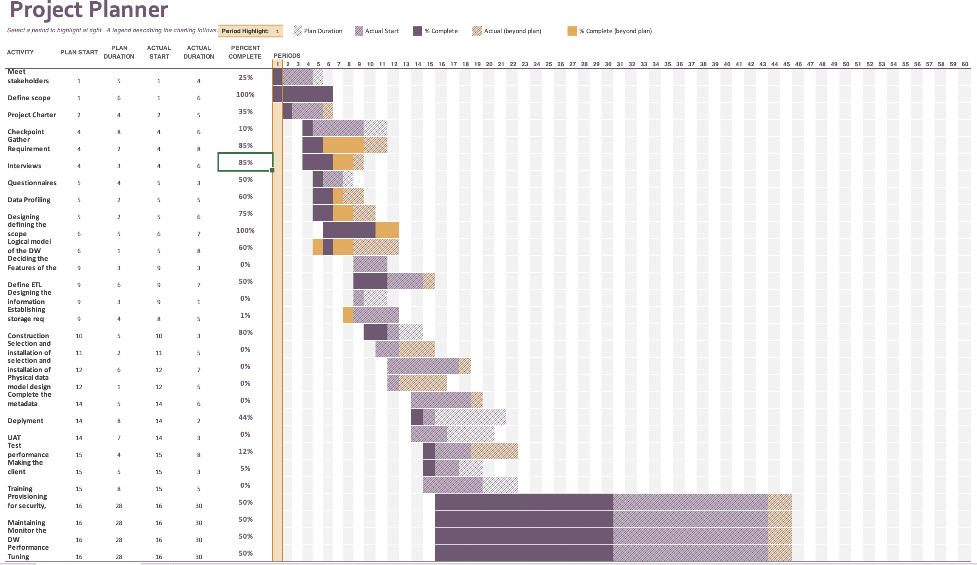
WBS

Slide 9
Issues
Cost of construction of a database.
Data Quality-Unstructured, vague, and undefined source data
Change Management-Training the concerned people
Lack of technical skills
Time constraints
Fuzzy testing scenario
Ensuring acceptable performance

Slide 10
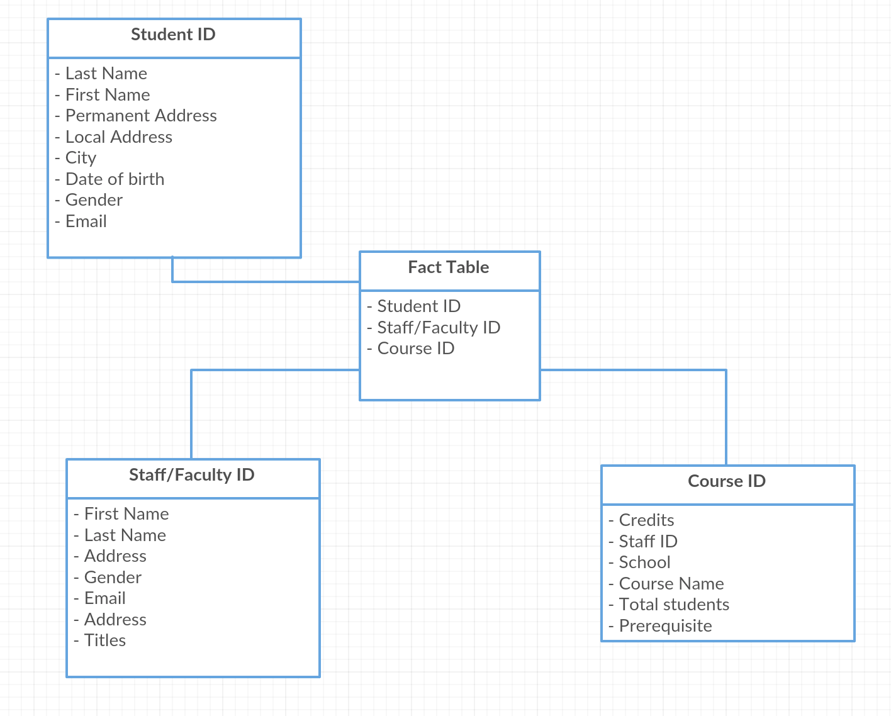
Star Schema

Slide 11
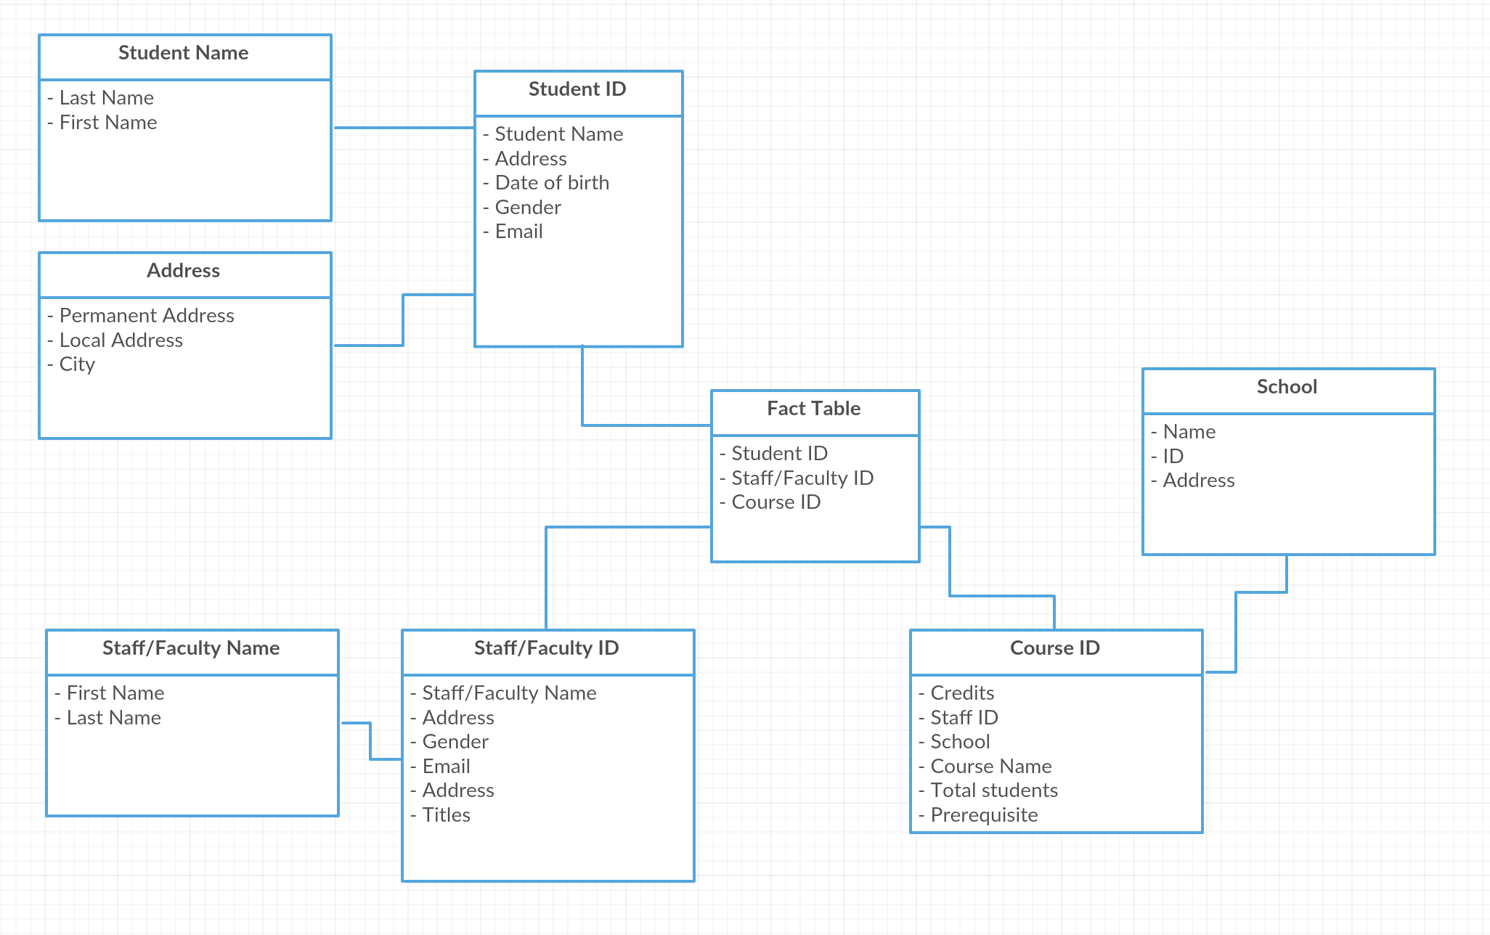
Snowflake Schema

Slide 12
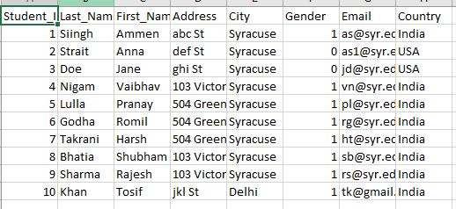
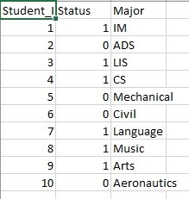
Data profile- Students
The source data for Students was located in two excel files:

Slide 13
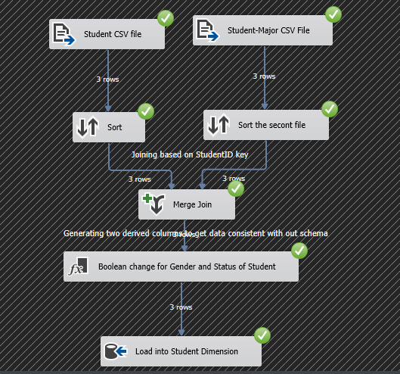
Loading Student through SSIS

Slide 14
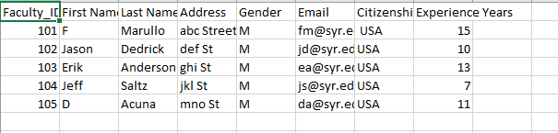
Data profile - Faculty
The faculty data was present in a CSV file and since it was in the desired format we only had to load it into our data warehouse.

Slide 15
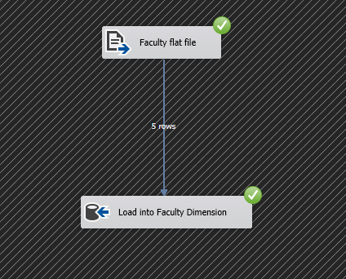
Faculty Loading using SSIS

Slide 16
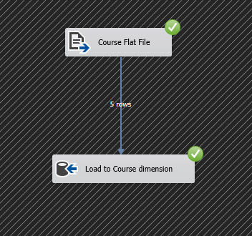
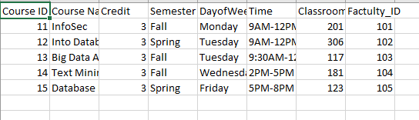
Course Loading

Slide 17
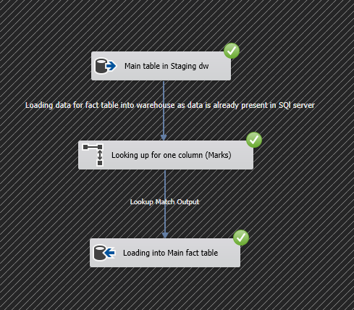
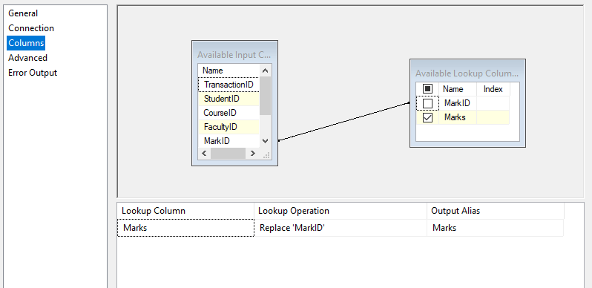
Fact Table Loading

Slide 18
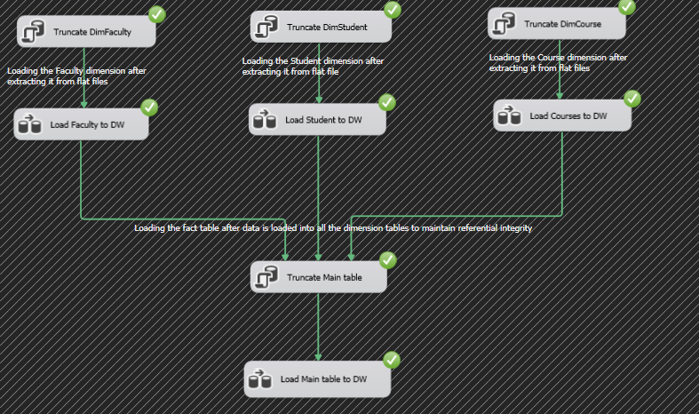
Overall ETL- SSIS

Slide 19
Cost
Roles | Number | Amount | Duration | Cost
Data Modeler | 1 | $ 90,000.00 | 0.1 | $ 9,000.00
DBA | 1 | $ 80,000.00 | 0.5 | $ 40,000.00
ETL Developer | 1 | $ 90,000.00 | 0.9 | $ 81,000.00
Front End Developer | 1 | $ 80,000.00 | 0.5 | $ 40,000.00
OLAP Developer | 1 | $ 70,000.00 | 0.5 | $ 35,000.00
Project manager | 1 | $ 100,000.00 | 1 | $ 100,000.00
QA Group | 1 | $ 90,000.00 | 0.5 | $ 45,000.00
Technical Architect | 1 | $ 110,000.00 | 0.8 | $ 88,000.00
Trainer | 1 | $ 80,000.00 | 0.1 | $ 8,000.00

Slide 20
Maintenance and support of the Data Warehouse
Monitoring the realisation of expected benefits
Providing ongoing support to users (see deployment)
Training new staff
Assisting with the identification and cleansing of dirty data
Maintaining both feeds & meta-data as source systems change over time;
Tuning the warehouse for maximum performance (this includes managing indexes and aggregates according to actual usage)
Purging dormant data
Recording successes and using these to continuously market the warehouse

Slide 21
Lessons Learnt
You need a business champion
Get project sponsors on board
Understand the business drivers
Know the problem to be solved
Build technology and business partners
Scalable implementation strategy
Continue to sell the benefits
Prepare for change

Slide 22
Thank You
QUESTION?

